Slide 1
DI AND HOW IT SHAPES YOUR APPLICATION

Slide 2

Marian Zlatev
Senior Software Engineer at Paysafe
Java and Go
marian.zlatev@paysafe.com

Slide 6
What is DI?
Class A
Class B

Slide 7
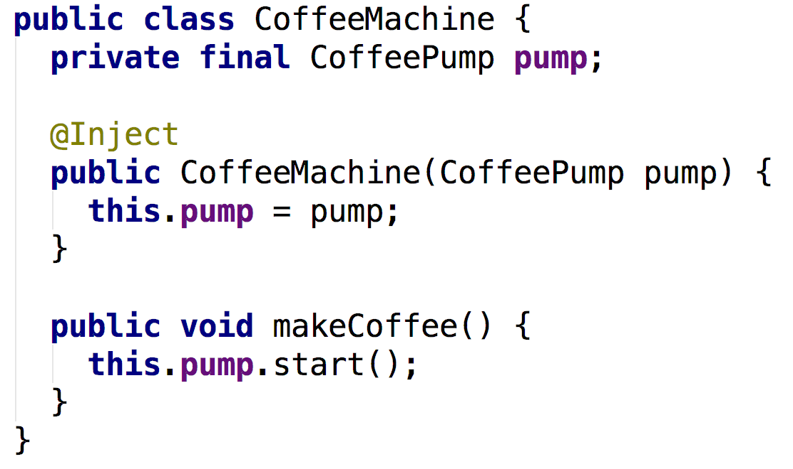
Constructor Injection

Slide 8
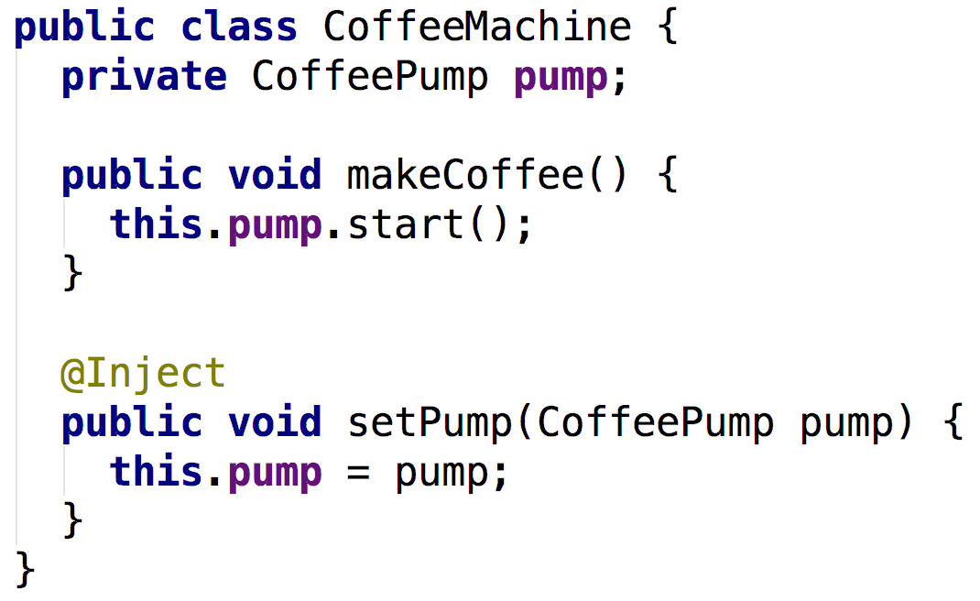
Setter Injection

Slide 9
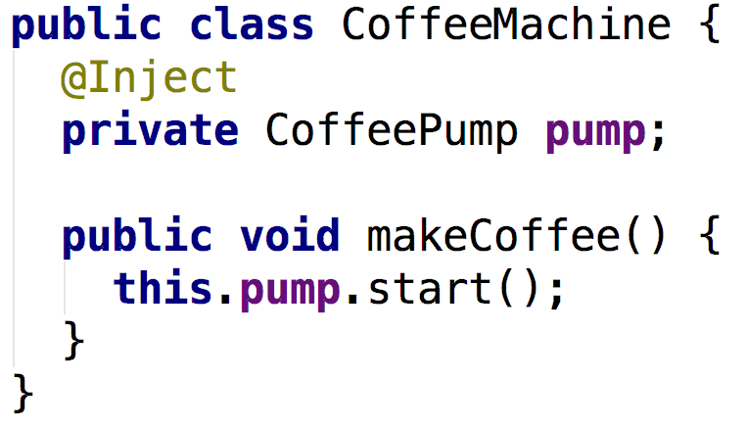
Field Injection

Slide 10
How to benefit from DI
Writing modular code
Keeping the code open for extension
Design by interface and increase cohesion
Easy to test

Slide 11
DI Frameworks
Spring
Guice
Dagger
Other

Slide 13
Modularity

Slide 14
Constructing the application

Slide 15
Guice Modules

Slide 16
High level policy depending on Low level policy
Class A
Level 1
Class B
Class C
Level 2
Class D
Class E
Class F
Class G
Level 3

Slide 17
CoffeeMachine
ElectricCoffeePump
CoffeeMachine
CoffeePump
ElectricCoffeePump
ManualCoffeePump

Slide 18
Class A
Level 1
Interface B
Interface C
Class B Impl
Class C Impl
Level 2
Interface D
Interface E
Class D Impl
Class E Impl
Level 3

Slide 19
Inversion of control

Slide 20
Hexagonal Architecture
WEB
PAYMENT GATEWAY
BUSINESS LOGIC
PERSISTENCE

Slide 21
Primary/Driving Adapters
Secondary/Driven
Adapters
CORE
Use Case
PRIMARY ADAPTER
Details
<I>
<I>

Slide 22
Email Adapter
ADMIN VIEWS & CONTROLLERS
Email lib
Admin Use Case
BUSINESS LOGIC
DB Adapter
SQL driver
Consumer Use Case
CONSUMER VIEWS & CONTROLLERS
Payment Adapter
PayPal SDK

Slide 24
Email Adapter
ADMIN VIEWS & CONTROLLERS
Email lib
Admin Use Case
BUSINESS LOGIC
DB Adapter
DB Adapter
SQL driver
Consumer Use Case
NoSQL lib
CONSUMER VIEWS & CONTROLLERS
Payment Adapter
PayPal SDK

Slide 25
DEMO

Slide 26
What to remember from this Talk
Spend time to research
Pick a DI framework
Use constructor Injection (unless you have a good reason not to)
Separate functionality into modules (packages)
Depend on Interfaces when details are involved
Interfaces should express intention

Slide 27
Q & A time?

Slide 28
Thank you
NewestUser/Hexagonal
marian.zlatev@paysafe.com

